Slide 1

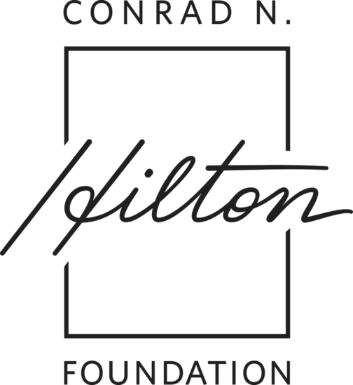
Expanding Opportunities for Young People in New Orleans: Evolution and Impact

Slide 2

"My hope is that we can build a world where everyone belongs, where the systems around us help young people lead thriving and healthy lives."
– OY Leader

Slide 3

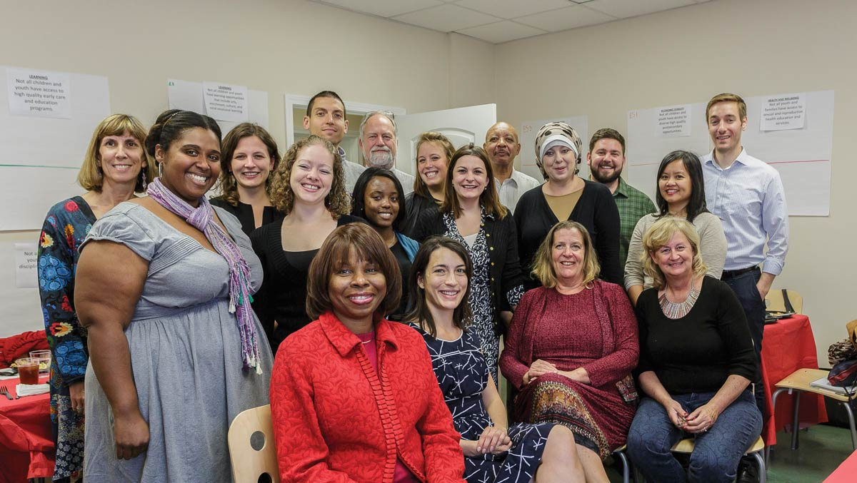
PROJECT OVERVIEW
The New Orleans Opportunity Youth Storytelling Initiative, funded by the Conrad N. Hilton Foundation, gathered stories, data, and research to highlight the growth and impact of New Orleans' youth support network since 2011.​

Slide 4
METHODOLOGY
CNHF Internal Interviews
Qualitative Interviews
Quantitative Research
1
Conduct Stakeholder Interviews and Qualitative Research
A
B
C
Selected CNHF OY initiative staff
29 interviews completed with OY ecosystem leaders
A review of key research and data reports evaluated
2
Synthesize Interviews and Research
3
Develop Opportunity Youth (OY) Presentation
4
Ongoing Feedback and Refinement (e.g., Frameworks Narrative and Direct Input from Leaders)

Slide 5
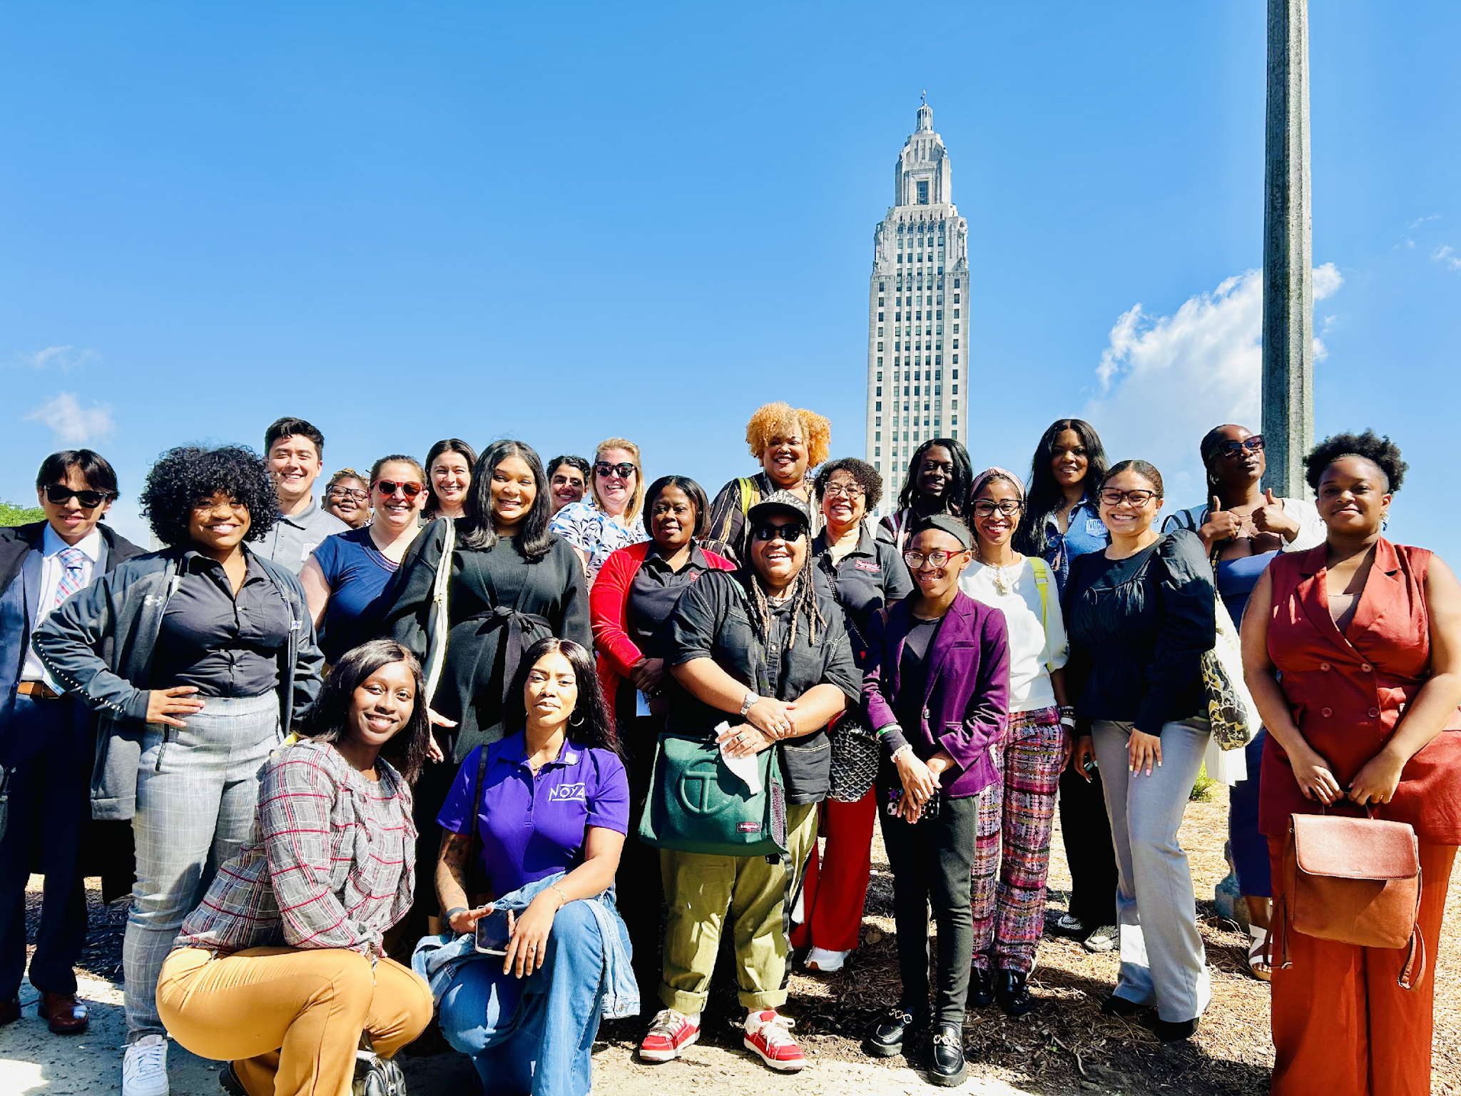
EVOLUTION OF THE OPPORTUNITY YOUTH ECOSYSTEM​​
This overview explores the evolution of New Orleans' youth support network, highlighting key milestones, lessons learned, and future aspirations for both the initiative and the city's young people.

Slide 6
Over the past 14 years, New Orleans' youth support network has grown from a series of coordinated efforts into a fully integrated system of resources and opportunities.​
From Coordination…
…to Integrated Capabilities
Coordinated Efforts
14 Years of strategic effort and big bets
Integrated Capabilities
That evolution was made possible by unrelenting strategic effort, continuous improvement, and big bets to support Opportunity Youth (OY) leaders, young people, and the organizations that serve them.​

Slide 7
During that time, strategic priorities evolved to drive positive, collective impact
In 2015, YouthShift NOLA launched with a foundational set of priorities aimed at fostering collective impact for young people. Over the next 10yrs, the NOLA OY ecosystem expanded upon these priorities, developing integrated capabilities to drive positive outcomes​.
Strategic Priorities
Coordinated Efforts
Integrated Capabilities
Data and Research
Data Community of Practice
Backbone Org Support
Population Focus (Supports and Seats)
Pilot Program Quality
Robust Program Quality
Youth Voice
Voice and Narrative Change
Policy and Advocacy

Slide 8
The diagrams below are an alternative illustration of those key strategic priorities.
Data & Research
Data Community of Practice
Voice and Narrative Change
Population focus (Supports and Seats)
Youth Voice
Coordination
Backbone Supports
Integrated
Capabilities
Defining Program Quality
Policy / Advocacy
Robust Program Quality
2015 New Orleans YouthShift Priorities, which sets the stage of the OY ecosystem
Current OY Ecosystem Priorities
(2020 – 2025)

Slide 9


Data and Research
CHAPTER 1
Coordination
Youth Voice
Backbone Supports
Coordinating Efforts: A Rallying Call for Better Outcomes for Young People ​(2011-2019)
Program Quality

Slide 10




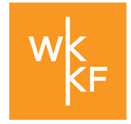
In Dec 2010, the White House Council for Community Solutions drew attention to the promise of 6.7M disconnected youth
National and local funders and champions built on White House momentum to bring support to New Orleans Youth.
Several funders played a critical role to galvanize support in NOLA
…And achieve early-stage milestones
Baptist Community Ministries (BCM)
Aspen launched the Opportunity Youth Incentive fund (OYIF) and Forum for Community Solutions and in June 2013 provided $500k to communities², in which Partnership for Youth Development (PYD) in NOLA was recipient
JPMorgan Chase
Aspen Institute, OYIF
BCM and Partnership for Youth Development in New Orleans established YouthShift, a collaboration of 200 youth-serving orgs which adopted a whole-child, collective-impact approach to improve the academic, social, and behavioral outcomes for New Orleanians ages birth to 25 with assistance from the Forum for Youth Investment (FYI)
WK Kellogg Foundation
Source:
¹The White House Council for Community Solution, Final Report, Community Solutions for Opportunity Youth, June 2012
²Aspen Institute, Press Release, July 2012
³YouthShift, A Call for Connection, December 2015
The Aspen Opportunity Youth Incentive Fund (OYIF) launched in 2013 and was rebranded as the Opportunity Youth Forum in 2016.
Notes:
Aspen launched the Opportunity Youth incentive fund and Forum for Community Solutions in July 2012, supported by Bill and Melinda Gates Foundation, the Rockefeller Foundation, Bloomberg Philanthropies, The John S. and James L. Knight Foundation, and the Annie E Casey Foundation, Nancy and Miles Rubin, providing $500k to citivites and $1M in matching fund resources

Slide 11


Building on momentum, youth-serving orgs leverage data to forge a collective path forward
In 2015, seminal reports from BCM and the Data Center on Youth in New Orleans bring together the region around key data and a “why” narrative, highlighting YouthShift’s five priorities for collective impact for Youth-serving organizations​.
Key data points, as mentioned by YouthShift in 2015:
One in three of the 78,000 youth live in poverty in NOLA
Births to teen mothers and infant death rates higher than national averages
18 percent of 16-24 year olds didn’t work or go to school
YouthShift’s Five Priorities for Collective Impact​
Data Collection
Program Quality (YPQI)
Integrated Policy Agenda
Backbone org Supports
Youth Voice
Source:
¹ A Call for Connection: Bridging the Divide for New Orleans Children and Youth,

Slide 12
Staggering data surrounding black boys and young men became a rallying call for better outcomes
On the heels of the 10th anniversary of Hurricane Katrina, the City of New Orleans wrestled with a “tale of two cities” in which economic recovery was not equitable for all New Orleanians, specifically for African Americans.
In June 2013, a compelling Data Center report acknowledged 52% of Black Boys and Young Men of Color in New Orleans were out of the labor force and unemployed.¹
The share of African American men with an associate’s degree or higher was only 15% in 2009-11, the same as it was in 1980.
The 2010 Census showed that while African Americans made up 53% of New Orleans males, African Americans made up 84% of incarcerated male adults in New Orleans, impacting employability.
EMPLOYABILITY
EDUCATION
JUSTICE
In 2014, Mayor Mitch Landrieu announced a comprehensive economic opportunity strategy to connect young men to job opportunities associated with the city’s growing sectors²
Source:
¹Lindy Boggs National Center for Community Literacy at Loyola University and the Data Center, Recognizing the Underutilized Economic Potential of Black Men in New Orleans, pg. 8-11, 13-14

Slide 13
EMPLOY is funded as a central hub to coordinate and strengthen orgs that support young people in New Orleans​
In 2014, Aspens OYIF funds PYD and Cowen Institute for Public Education Initiatives (Cowen) to establish EMPLOY - Employment and Mobility Pathways Linked for Opportunity Youth (EMPLOY)¹.
Data and Research
Cowen and EMPLOY’s Priorities
Data and Research
Baseline OY Data
Backbone Supports
OY Pathways and Programs
Youth Voice
Coordination
Backbone Supports
Program Quality
NOLA-YPQI Pilot
Youth Voice
EMPLOY Youth Council
Program Quality
Source:
¹Aspen institute Re-Invests in Innovative Community Collaboratives to Engage “Opportunity Youth”
²Designing for Success: Lessons Learned in Opportunity Youth Incentive Fund Sites

Slide 14
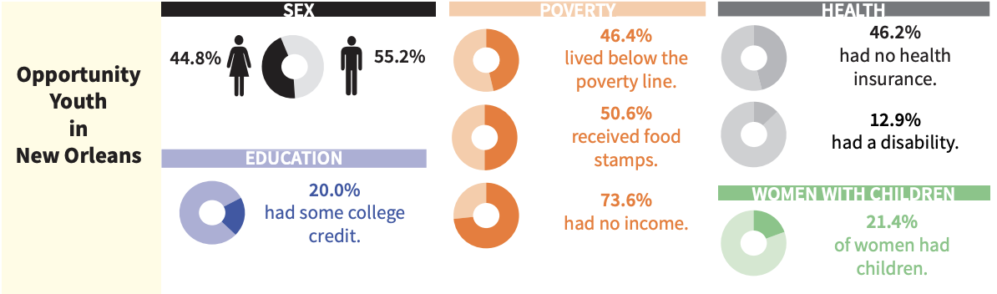
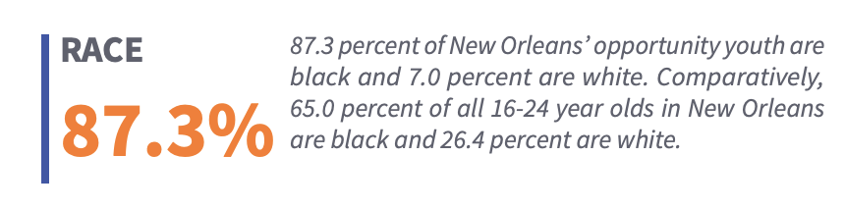
EMPLOY reports 6,820 youth are estimated to be out-of-work and school in New Orleans in 2016
In 2015, the Cowen Institute and EMPLOY release a report, No Longer Invisible: Opportunity Youth in New Orleans, that provides foundational data of OY in the city.​
A SHARED DATA COLLABORATIVE
Moreover, BCM, Aspen and others support EMPLOY and partners through the Opportunity Youth Data Sharing Collaborative to begin work on shared data using Efforts to Outcomes.
Efforts to Outcomes (ETO), a national platform for social service organizations to manage and track client data, was used as a common tool for OY-serving organizations in New Orleans to understand its collective impact.
In 2016, New Orleans had an estimated 6,820 opportunity youth¹
Reflection from Interviews: OY-serving organizations were initially hesitant to centralize data. Not all OY-serving organizations were being funded. Organizational leaders believed centralizing data would be more punitive and comparative in nature, and impact current and future business development.
Source:
¹The Cowen Institute at Tulane University, October 2016, No Longer Invisible: Opportunity Youth in New Orleans

Slide 15
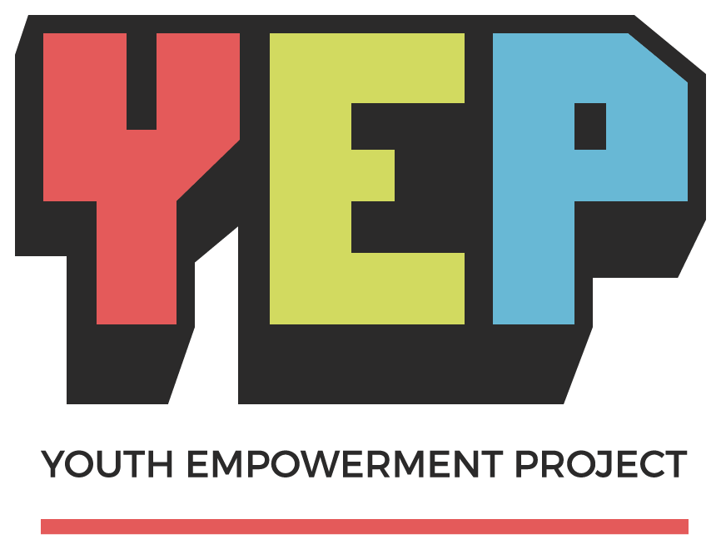




After three year pilot, ~500 young people ages 16-24 participated in EMPLOY’s Opportunity Works program
In 2016, Jobs for the Future received a grant from the Corporation for National and Community Service’s SIF program to implement Back On Track in seven cities across the U.S., including New Orleans, LA.​
Program Description
Opportunity Works was a 3-year effort led by Jobs for the Future to support Opportunity Youth in accessing postsecondary and career pathways
New Orleans Back on Track approach focused on postsecondary and career bridging
Opportunity Works allowed for increased capacity to provide a “no-wrong-door” approach across the four major organizations supporting the Back on Track model.
New Orleans Back on Track Program Core Components¹
Provided transition coordinators and High School Equivalency completion, work readiness, basic soft skills, and financial counseling
Provided post-secondary bridging and industry-based credentialing, including credit and non-credit coursework
Cowen’s Earn and Learn program provided an opportunity for paid work experience and on-the-job training linked to postsecondary education
Taught an early college liberal arts writing and reading seminar at Earn and Learn and YEP
Cowen Institute at Tulane University - Backbone Organization
Source:
¹New Insights into the Back on Track Model’s Effects on Opportunity Youth Outcomes, July 2019

Slide 16
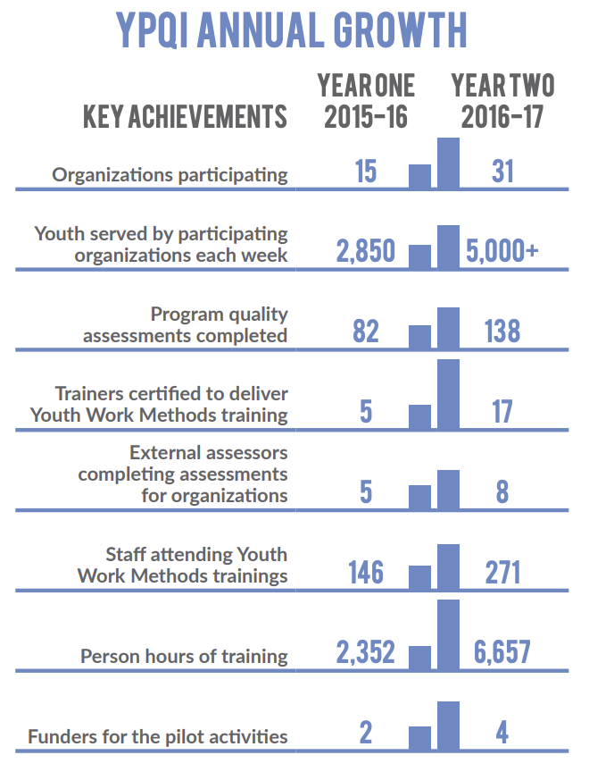

In 2017, the NOLA-YPQI pilot engaged 31 orgs to improve program quality, a 2x increase from the year prior
The NOLA Youth Program Quality Initiative (YPQI) was launched in 2015 to establish a system that would raise the bar for quality in out-of-school-time programs in New Orleans and produce better developmental outcomes for children and youth for years to come.
What is YPQI?
YPQI is based on the David P. Weikart Center for Program Quality’s youth program quality intervention, which has been adopted by more than 4,000 programs in 41 states.
This model assists program staff in
assessing the quality of their programs,
planning for improvement, and
participating in coaching and professional development experiences that help them institute measurable quality improvements
Source: NOLA-YPQI Pilot
Source:
¹New Orleans Youth Alliance Offerings - https://noya.org/offerings
²New Orleans Youth Program Quality Initiative

Slide 17
The EMPLOY collaborative and partner orgs supporting young people continued to drive meaningful progress.​
Selected Key Wins
From 2012 to 2017, funders and OY-leaders built momentum as a result of federal, national, and local funder investment, the collaboration of 200 youth serving orgs, and city funding and narrative to prioritize Youth and OY.​​
OY developed a shared case management system among orgs using Efforts to Outcomes (ETO) to collect OY data and career pathways progression ​​
EMPLOY and partners led a three-year Social Innovation funded demonstration pilot, Opportunity Works, which served over 500 opportunity youth as they transitioned from high- school and HiSet programming to post-secondary and employment​​
The collaborative created new advancement pathways for opportunity youth with local employers and established new employer/training provider partnerships​​
Innovative Programming - YEP and Bard College created new programs with Delgado​​

Slide 18

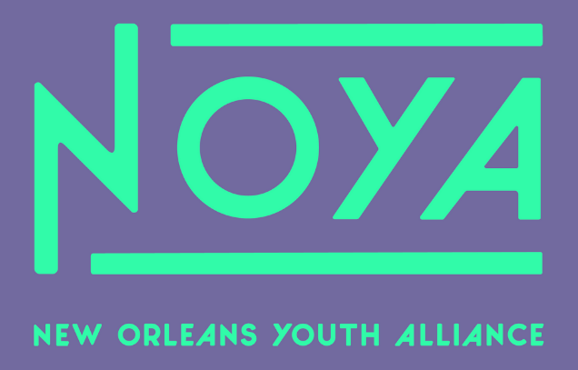

However, major challenges begin to emerge that slowed the momentum and priorities of NOLA OY movement
In 2018, funders asked several leading stakeholders to apply and lead a newly formed OY collaborative in New Orleans. NOLABA and NOYA were selected until a full transition of responsibilities to NOYA and the New Orleans Children and Youth Planning Board
1
Shift in Anchor Org
2
Leadership Transitions
3
Current Collaborative Anchor Organizations
EMPLOY seeks organizational home outside of Cowen and is unsuccessful at securing financial backing; EMPLOY is sunset
NOLABA, the New Orleans regional economic development agency, receives OY funding but undergoes key leadership transitions that disrupt the continuation of OY work; NOLABA steps down as anchor
The New Orleans Youth Alliance, which convened OY non-profit partners, played an important role in crafting new strategy and programming, leveraging youth participation in the design and development
CYPB, given its existing mandate with the City of New Orleans, became an integral partner to the New Orleans Youth Alliance (NOYA)
Underlying Challenges
Funders seeks to better align NOLA OY anchor org with the OY community
BCM, a major local funder and champion, shifts population focus to Early Childhood Education

Slide 19
2020 marked a pivotal moment for the evolution of New Orleans' youth support network
Four major lessons emerged that would serve as the foundation for the next phase of strategic focus for the New Orleans Opportunity Youth Ecosystem
Four Early Lessons Learned
Lesson 1
Lesson 2
Lesson 3
Lesson 4
National and local philanthropic collaboration is essential to understanding proximate needs
Data collection and collaboration happen at the speed of trust; sustainable funding is integral
Funding champions and leadership transitions have outsized impacts on progress
Youth-serving organizations must sit at the center of the OY evolution and require support and scaffolding

Slide 20

Data Community of Practice
Voice and Narrative Change
Population focus (Supports and Seats)
CHAPTER 2
Integrated
Capabilities
Integrated Capabilities: Making Big Bets and Delivering Key Wins (2020-2025)
Policy / Advocacy
Robust Program Quality

Slide 21

The youth support network took bold steps to enhance its capabilities for long-term impact from 2020 to 2025​
Current OY Ecosystem Priorities
Big Bets and Key Wins
Data Community of Practice
Data Community of Practice
Data Sharing
Voice and Narrative Change
Population focus (Supports and Seats)
Population Focus (Supports and Seats)
Distributed backbone support orgs
Integrated
Capabilities
Robust Program Quality
Scaling Program Quality
Youth Voice and Narrative Change
Building power and narratives
(Frameworks, and LEDE)
Policy / Advocacy
Robust Program Quality
Policy and Advocacy
Youth Master Plan, Ride New Orleans, and State Power Building

Slide 22






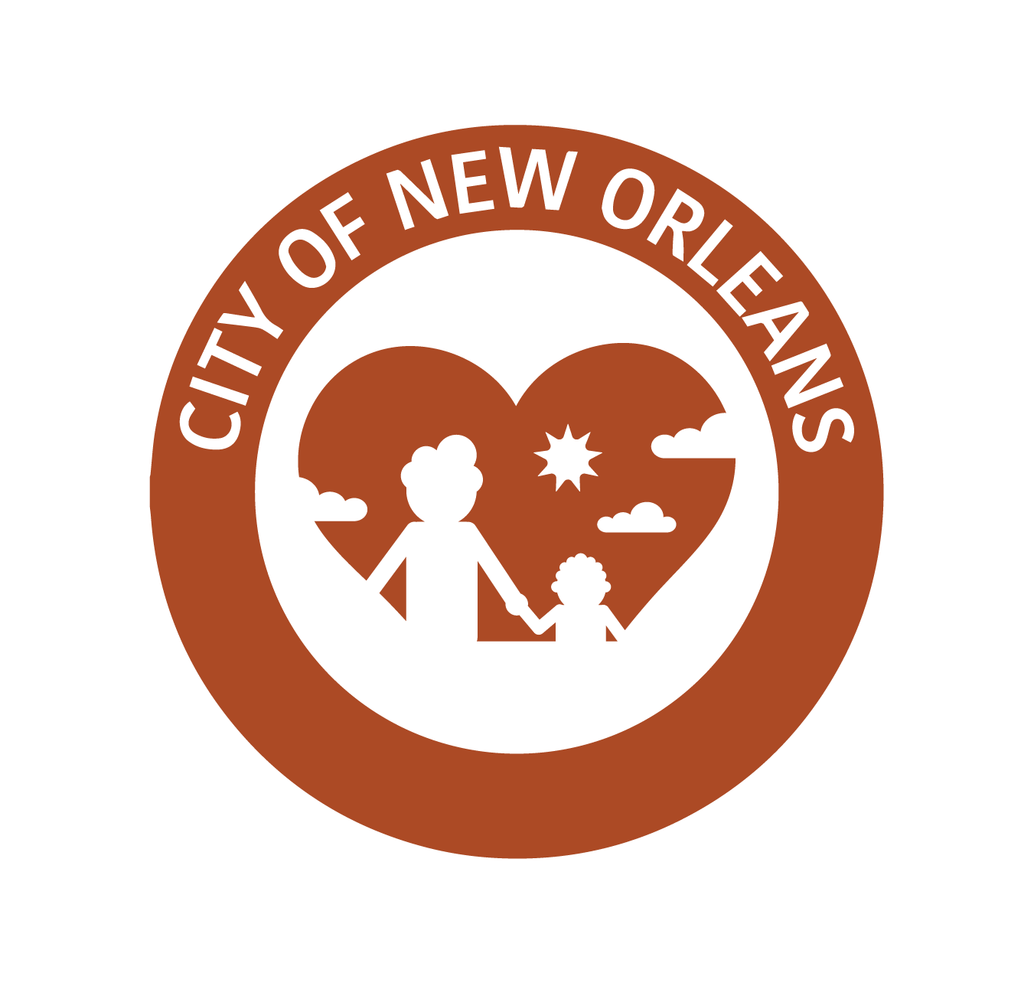
Six New Orleans orgs set 10 common metrics to create a shared dashboard for collective impact
New Orleans CYPB took lessons from OY Data Sharing Collaborative* (OYDSC) for Data CoP and chose to prioritize customization of ETO (by org), 1:1 technical assistance, and orgs sharing learnings of ETO within Data CoP; common/shared metrics were identified in fall 2024
Common Metrics for New Orleans OY Partners
Partners
Identity Metrics
Education + Employment
Purpose + Well-being
Demographics
Barriers
Justice System Avoidance
Financial Capacity
Employment / Job Retention
Program Completion
Earned Certifications
Self Efficacy
Social Emotional Learning and Well-being
Youth Engagement
*The data collaborative, led by NOLA CYPB, provides technical resources for OY serving organizations to collect data using Efforts to Outcomes platform.
Youth Data Hub efforts are underway with the City of New Orleans and will include opportunity youth and youth-program more broadly.
Notes:
Additional notes: OYDSC prioritized shared definitions and shared data, orgs struggled to adopt/find value in ETO use
DATA CoP = Data Community of Practice

Slide 23
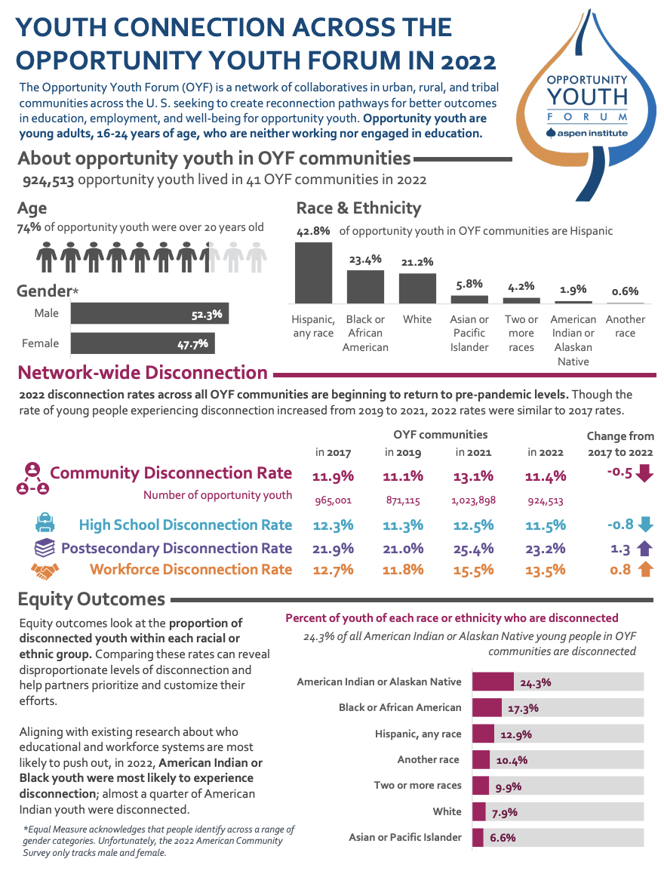
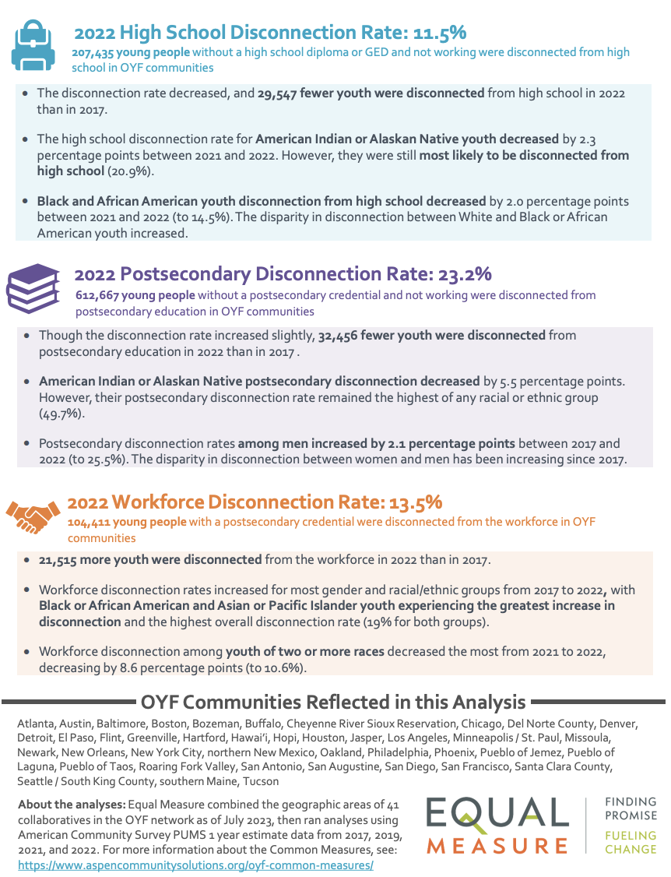
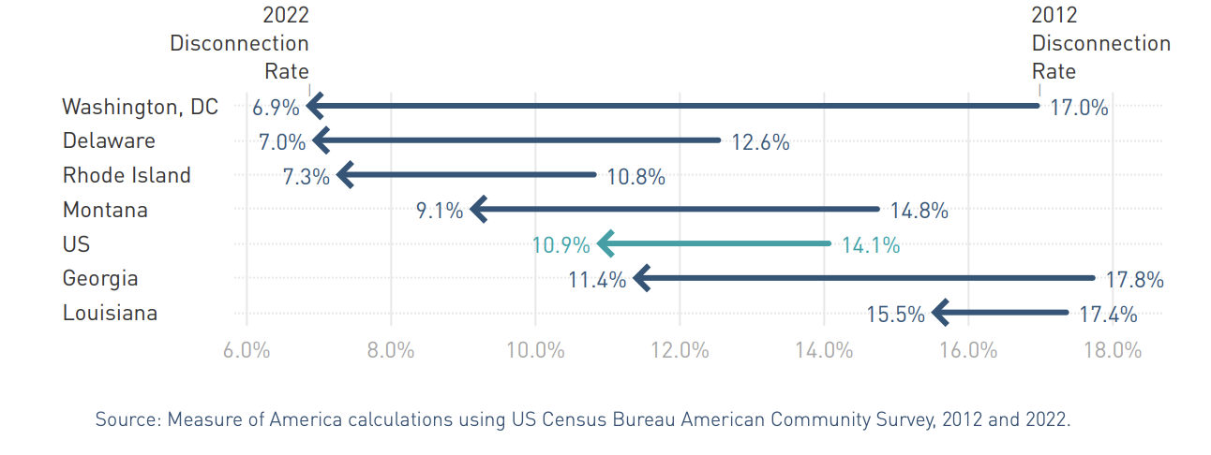
Aspen’s Common Measures and MOA’s Youth Disconnection reports give national context to local data
Aspen’s OYF Common Measures 2021 report
Significant Change in Youth Discussion by State, 2012 - 2022
Aspen's Common Measures sets out to establish youth outcomes
MOA’s 2022 National Youth Disconnection Rates
Measure of America (MOA) newly published report on Youth Disconnection shows Louisiana with the highest rate of youth disconnection (15.5%), while the national average is 10.9%.
The total decline in youth disconnection from 2012 to 2022 in Louisiana (1.9%) lagged the U.S (3.2%)
The New Orleans metro – Metairie, LA region ranked 80th with 5,122 disconnected youth (~12.2% of all youth)
OYF Common Measures tracks youth outcomes across OYF communities using the American Community Survey to track disconnection rates: community, high school, postsecondary, and workforce
In 2022, New Orleans had 5,122 (12.2%) community disconnection youth, compared to the OYF network average of 11.4% and national disconnection rate of 10.9%.
Source:
1 - Aspen institute Re-Invests in Innovative Community Collaboratives to Engage “Opportunity Youth”
2- Designing for Success: Lessons Learned in Opportunity Youth Incentive Fund Sites

Slide 24








Furthermore, LA FIRST was signed into law in 2023 and funded to establish a new longitudinal data system
The Louisiana Foundational Integrated Research System for Transformation (La FIRST) will sit under the authority of the Board of Regents and be housed at the Kathleen Babineaux Blanco Public Policy Center at the University of Louisiana – Lafayette (ULL).
Entities Participating in LA FIRST Data Share*
As stated in the legislation, LA FIRST shall develop and annually publish the following reports:
Launch Louisiana report with an in-depth analysis of the elementary-and-secondary-school-to-college or –career transition
Louisiana Employment Outcomes with linkages between workforce, credit, and noncredit, and post-secondary training and education
Causes and Consequences of Criminal and Delinquent Acts reports with analysis of the criminal justice system leveraging linkages between education, employment, adult corrections, and juvenile justice.
All post-Secondary Public Education institutions
The data provides the OY ecosystem an ability to track outcomes and conduct studies to analyze pathways of OY across the state.
Note:
* ULL is currently in the process of entering into data-sharing agreements with all the agencies named in the law.
Source:
¹Louisiana State Legislature RS 17:318.2
Notes:
Source: https://legis.la.gov/legis/ViewDocument.aspx?d=1332593.

Slide 25
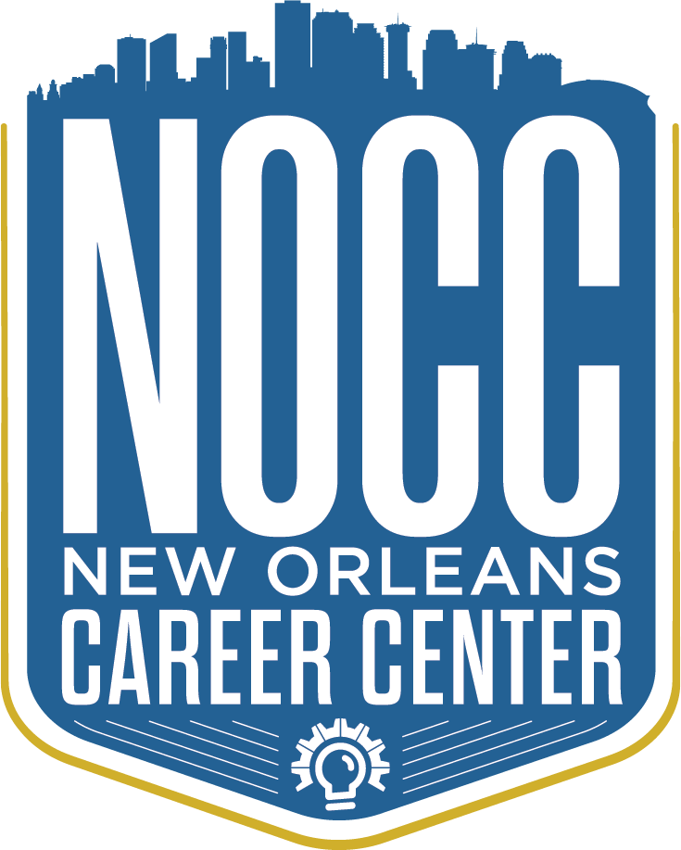
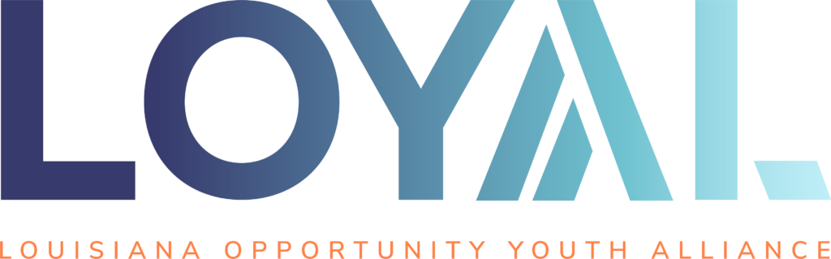


The youth support network established new, effective backbone supports to help young people stay connected and thrive
The fundamental shift in the New Orleans OY ecosystem is the distribution of support to a set of organizations that provides leadership on pathways connection, organizational development, program quality, advocacy and education, and population support
Backbone OY Support Organizations
Detailed descriptions to follow
Notes:
Add invest in Louisiana

Slide 26
The NOCC credentials adult trainees and is expanding into new areas to provide industry-informed training with trainee-informed support
New Orleans Career Center (NOCC) equips the city's young people with the technical skills, the career prep, and the professional networks to succeed in high-wage, high-demand industries.
Workforce Development and Training Programs
Impact of Collaboration and Partnerships
NOCC's highly interconnected network of diverse partners — from Clover and United Way to Ochsner Health and LCMC Health, Broadmoor Construction and All-Star Electric — helps ensure training meets both trainee and employer needs. These interwoven connections lead to better preparation and more job opportunities for trainees.
NOCC is an anchor organization in the OY ecosystem. Hands-on technical training and employer engagement combine with extensive support and resources to maximize trainees' skills and opportunities.
NOCC has expanded training for OY to include industry-based credentials in
Building Trades - NCCER core training across trades, plus specializations in electrical, welding, and HVAC Healthcare - EMT, Medical Assisting, Patient Access Associate, Pharmacy Tech
Opportunities
Employer engagement
Alignment with economic demand - NOCC trains for jobs that exist, highlighting the need for stronger and more sustainable partnerships
Navigating the complexities of federal and state funding, particularly SNAP Education and Training funds
Lack of community awareness about available training pathways and funding
Accessibility of data to external parties
Source:
¹New Orleans Career Center Impact Report 2023
Notes:
"We need better employer engagement and case management structures to ensure that the training we provide aligns with economic demand and leads to meaningful job placements for our participants.” – NOCC Leadership​

Slide 27

At the Re-Engagement Center, 18 multi-sector partners convene to reduce disconnection rates 7% by 2026 among youth ages 16-24
The Re-Engagement Center (REC) is a free resource center for New Orleans youth ages 16-24 connecting youth to post-secondary opportunities and/or careers.
The New Orleans Youth Alliance (NOYA) is a healing-centered youth development intermediary for the Greater New Orleans area that works to cultivate a system of high-quality, well-resourced youth development orgs.
The REC, an initiative of NOYA, is a collaboration of multi-sector partners that includes workforce development programs, city agencies, employer providers, and higher education institutions
One major goal of the Re-Engagement Center is to drive disconnection rates down 7% by 2026
Notes:
The New Orleans Youth Alliance (NOYA) is a healing-centered youth development intermediary for the Greater New Orleans area. NOYA works to cultivate a system of high-quality, well-resourced youth development organizations that center youth leadership, racial equity and intersectional equity in their work with young people. NOYA achieves its mission through three key areas of service: program quality and professional development, policy and advocacy, and organizational effectiveness.
The Reengagement Center (REC) is a free resource center for New Orleans youth ages 16-24.

Slide 28



In 2023, the New Orleans Children’s Bureau developed a new model to meet mental health needs for youth
The New Orleans Children’s Bureau of New Orleans supports more than 3,000 children and their families annually, promoting growth and resilience through prevention, advocacy, education, and intervention
The New Orleans Children’s Bureau of New Orleans CMHWs Program
Community Mental Health Workers (CMHWs) are a new peer-support model to meet the mental health needs for workforce program participants ages 18-24
CMHWs complete a minimum of 5 weeks of training, including a 2-week state-approved Peer Support Specialist training module that expands upon the role of peers on mental health and substance abuse treatment teams.
They are then matched with one or more youth workforce provider agencies alongside a mental health clinician
CMHWs are permanent, salaried, and full-time employees
Services that CMHWs provide to peers include:
Mental health education
Outreach to program participants
Connections to care
Support to young people already receiving clinical services
Nonjudgmental support with an emphasis on empowerment
Emotional support during and between Children's Bureau trauma therapy sessions
Collaboration and advocacy with other treatment providers and case managers
Support in overcoming barriers to accessing mental health care
Source:
¹The Center for Law and Social Policy

Slide 29






Along with these support systems, workforce training CBOs are empowering hundreds of young people with the skills and resources to thrive
New Orleans OY-serving CBOs are essential, as they are on the frontline with OY, developing supportive partnerships, and working collaboratively with backbone organizations and community to achieve meaningful impact
Success of Community-Based Workforce Programs…
…and programmatic partners support CBOs:
CBOs provide comprehensive on-the-job training experience, address individual barriers, and educational pathways for careers and college.
These organizations serve hundreds of OY each year.
Education institutions (e.g., Delgado Community College)
Mental Health services (e.g., Children’s Bureau)
Professional training and advancement through SNAP benefits
Justice-involved population support and development
Employers

Slide 30
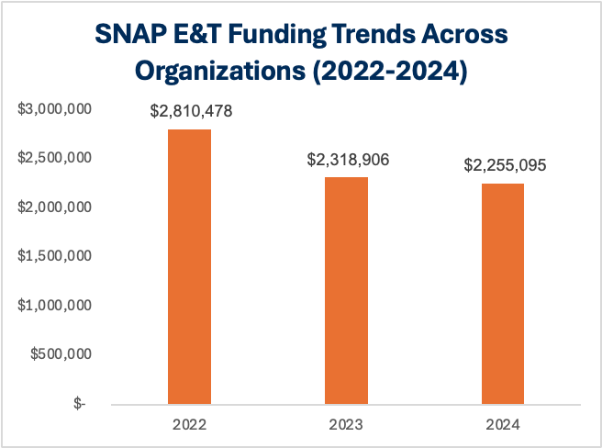
New Orleans youth-serving orgs collectively received $7.38M in SNAP E&T funding from 2022-2024, averaging $2.46M annually to support OY programming
Louisiana's SNAP E&T initiative provides skills training and work experience for SNAP recipients.
A number of OY-serving nonprofit orgs are successfully leveraging SNAP E&T reimbursements to create sustainable, braided funding models that complement philanthropic grant dollars
Despite modest year-over-year decreases, orgs have collectively maintained strong funding levels with a total of ~$7.38M from 2022-2024, $2.46M annually
Source: NOCC, Cafe Hope, Cafe Reconcile, Operation Restoration, YEP, Liberty Kitchen, Cowen Institute — SNAP E&T Funding Data and Context (2022–2024), provided to author via email communications, 2024.

Slide 31
In Year 9, the NOLA-YPQI Network consisted of 46 partners, serving approx. 40K young people in NOLA
40,000 young people throughout New Orleans are receiving quality service and program standards, aligned to evidence-based national best practices in Positive Youth Development
Reaching a Milestone:
In YR8 NOLA YPQI Network bested National Averages in all four assessment domains for the first time ever. Here are reflections on its success:
These accomplishments have taken nearly a decade to realize, so this work is not quick
This work requires deep integration into the youth-serving ecosystem.
Leadership and Innovation - FFYI
PQA is an assessment tool used through Weikert and is designed for after school K-12
FFYI/Weikart is only this year exploring the use of this tool with youth workforce orgs; NOLA has implemented for a decade
Source:
¹New Orleans Youth Alliance, Instagram

Slide 32
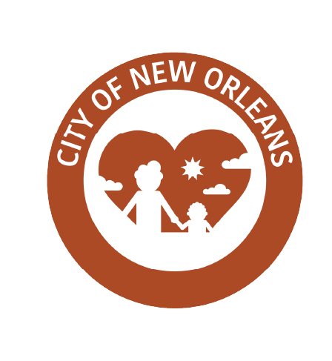
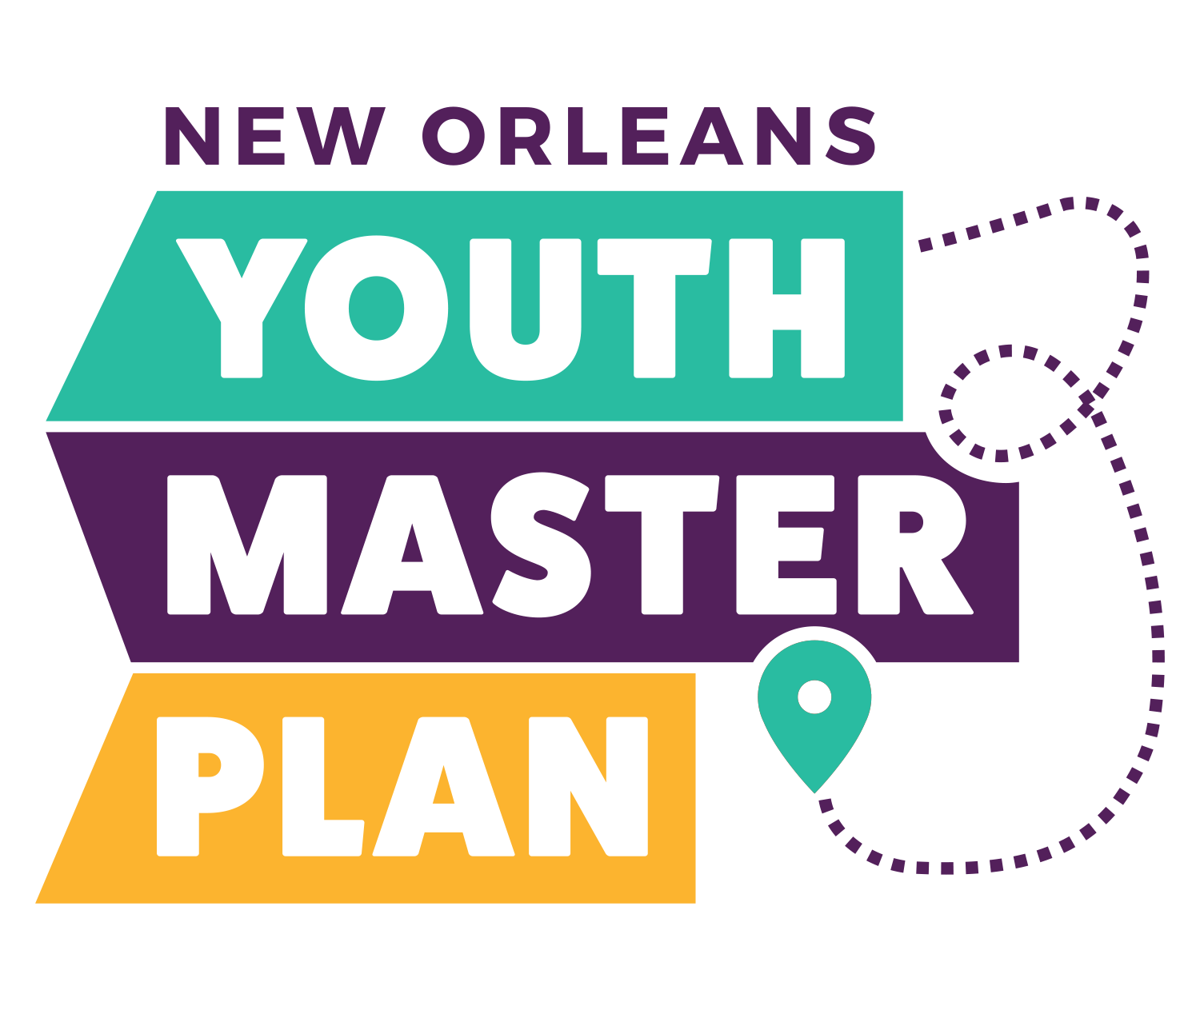
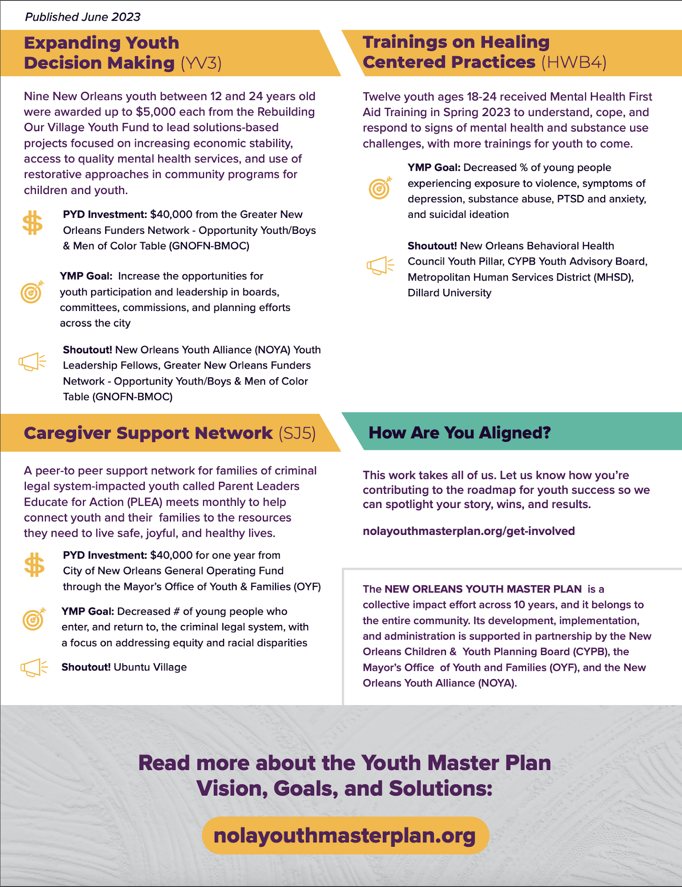
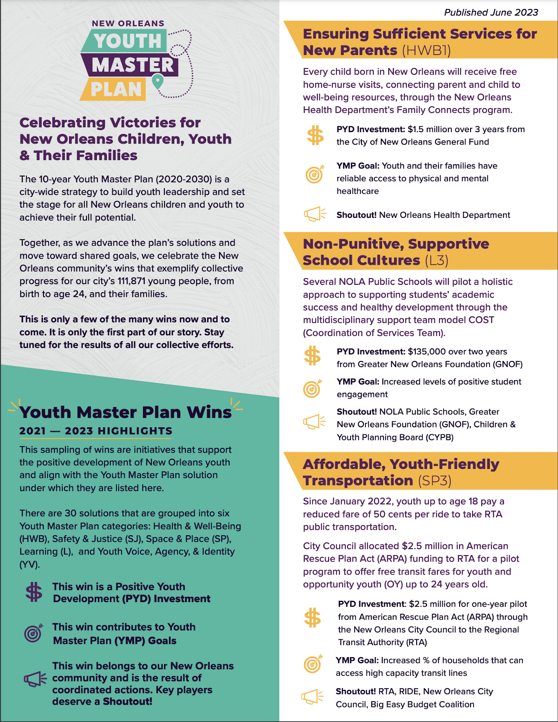
Partners celebrate victories for its Youth Master Plan, a plan adopted by the New Orleans OYF
Its development, implementation, and administration are supported in partnership by the New Orleans Children & Youth Planning Board (CYPB), the New Orleans Youth Alliance (NOYA), and the Office of Youth and Families (OYF).
Youth Master Plan Wins
June 2023
The Youth Master Plan is a comprehensive roadmap from 2020 - 2030 for creating and sustaining a positive, youth-development focused, results-oriented New Orleans that works for all our young people.
The Youth Master Plan brings together young people, parents, educators, community leaders and other key stakeholders to develop, implement, and monitor a ten-year, multisector plan for improving outcomes for our children and youth across Orleans Parish.
Key Wins examples:
Ensuring Sufficient Services for New Parents (free home-nurse visits)
Non-punitive, supportive school cultures (COST model)
Affordable, Youth-Friendly Transportation
Caregiver Support Network
Source: New Orleans Master Plan, June 2023
Notes:
The NEW ORLEANS YOUTH MASTER PLAN is a collective impact effort across 10 years, and it belongs to the entire community. Its development, implementation, and administration is supported in partnership by the New Orleans Children & Youth Planning Board (CYPB), the New Orleans Youth Alliance (NOYA), and the Office of Youth and Families (OYF).
“We need a reliable, frequent, and widespread transportation system. Without it, we’re leaving our most vulnerable populations stranded, unable to access the jobs and services they need to thrive.”​ - Transportation Leader

Slide 33
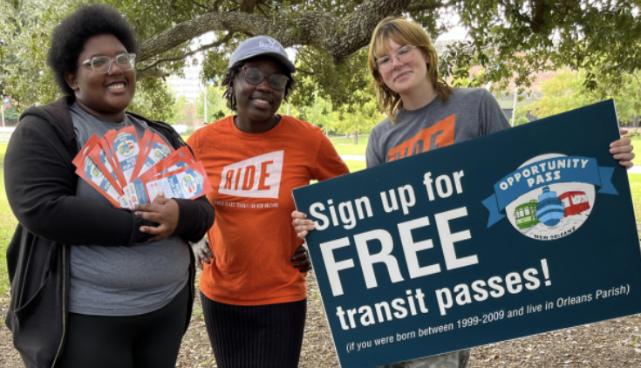
Advocacy efforts at the City of New Orleans led to free transit for youth; $2.5m in pilot funding
The Opportunity Pass Pilot Program is making free transit passes available to Orleans Parish residents ages 16 to 24. Program started September 3, 2024 and was initially scheduled to end August 31, 2025, but efforts are underway to continue it for another year to better utilize the funding received, with planned program enhancements including the addition of paper passes.
The City Council allocated $2.5m in American Rescue Plan Act (ARPA) funding to RTA for a pilot program, Opportunity Pass, to offer free transit fares for youth up to 24 years old
What does bulk enrollment and implementation look like?
The New Orleans Public Library is administering signups at library locations.
Ride New Orleans is managing the program, conducting outreach, performing impact assessments, and offering group enrollment workshops with transit literacy training at youth-serving organizations.
Available to Orleans Parish youth aged 16-24
Youth-developed program: transit ambassadors created all materials and processes, with youth focus groups providing program feedback
NOLA CYPB is assisting with program development and outreach and overseeing impact assessment and reporting in collaboration with RIDE.
The Regional Transit Authority is distributing passes and sharing usage data for program evaluation.
PROGRAM GOALS
Remove financial barriers to travel
Grow ridership for RTA transit
Educate the next generation
Collect data to improve transit for young adults.
Create the skills and confidence for lifelong public transit ridership.
Source: New Orleans Master Plan, June 2023
Notes:
“We need a reliable, frequent, and widespread transportation system. Without it, we’re leaving our most vulnerable populations stranded, unable to access the jobs and services they need to thrive.”​ - Transportation Leader

Slide 34
Major state policy win established the Louisiana OY Task Force with LOYAL members as leads
2024 OY Day at the Capitol followed the successful passage of Senate Resolution 47 (SR47), which establishes the Louisiana Opportunity Youth Task Force.
2024 OY Day at the Capital - LOYAL
The Task Force will study:
Ways of improving the lives of Opportunity Youth
Propose recommendations
Offer proposals for legislation, if necessary and appropriate.
The Task Force will consist of leaders
Two members of LOYAL
Lived experts of Louisiana OY population (current or past)
Louisiana Workforce Commission
Louisiana Department of Education
Louisiana Community and Technical College System
Department of Health, Department of Children and Family Services
The Commissioner of Higher Education,
The state-level OY Taskforce will likely have final recommendations that direct LA First on specific OY reports/studies that should be continually run to track OY outcomes statewide.

Slide 35
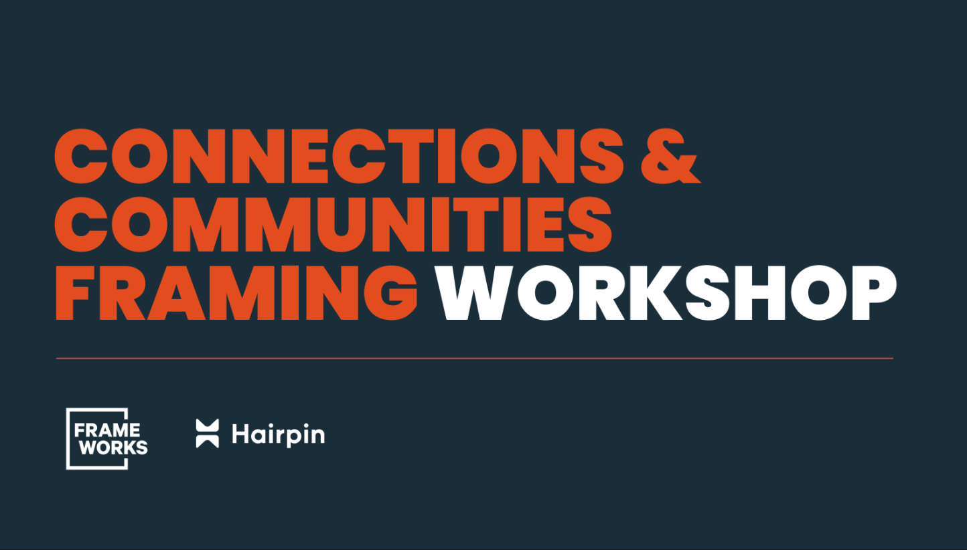
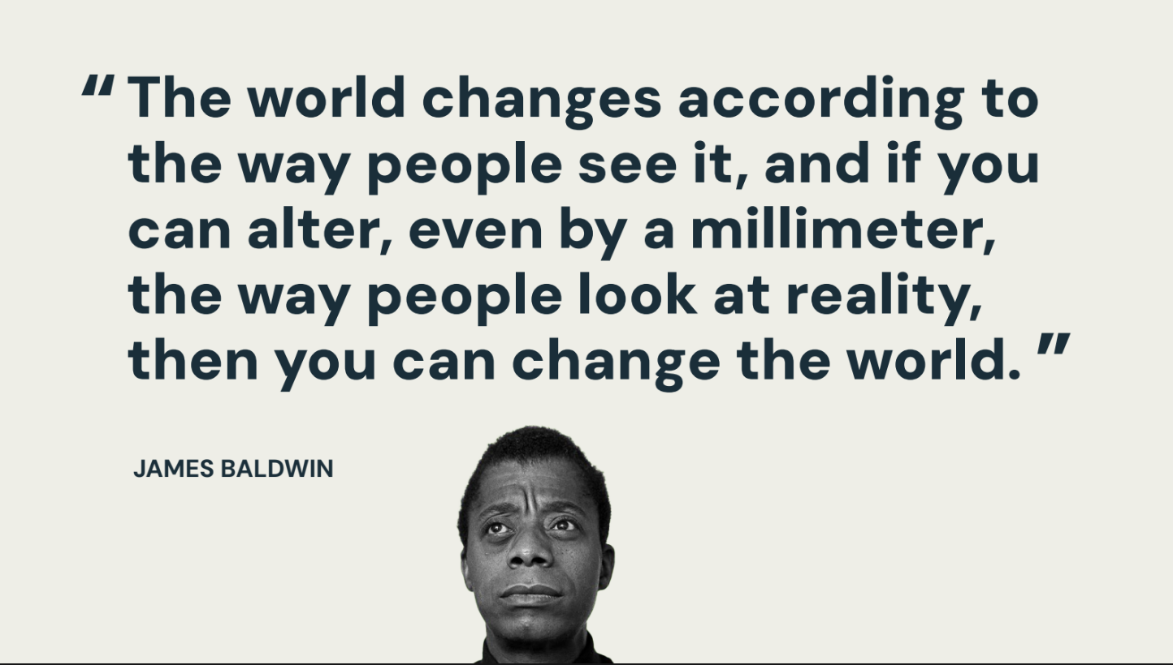
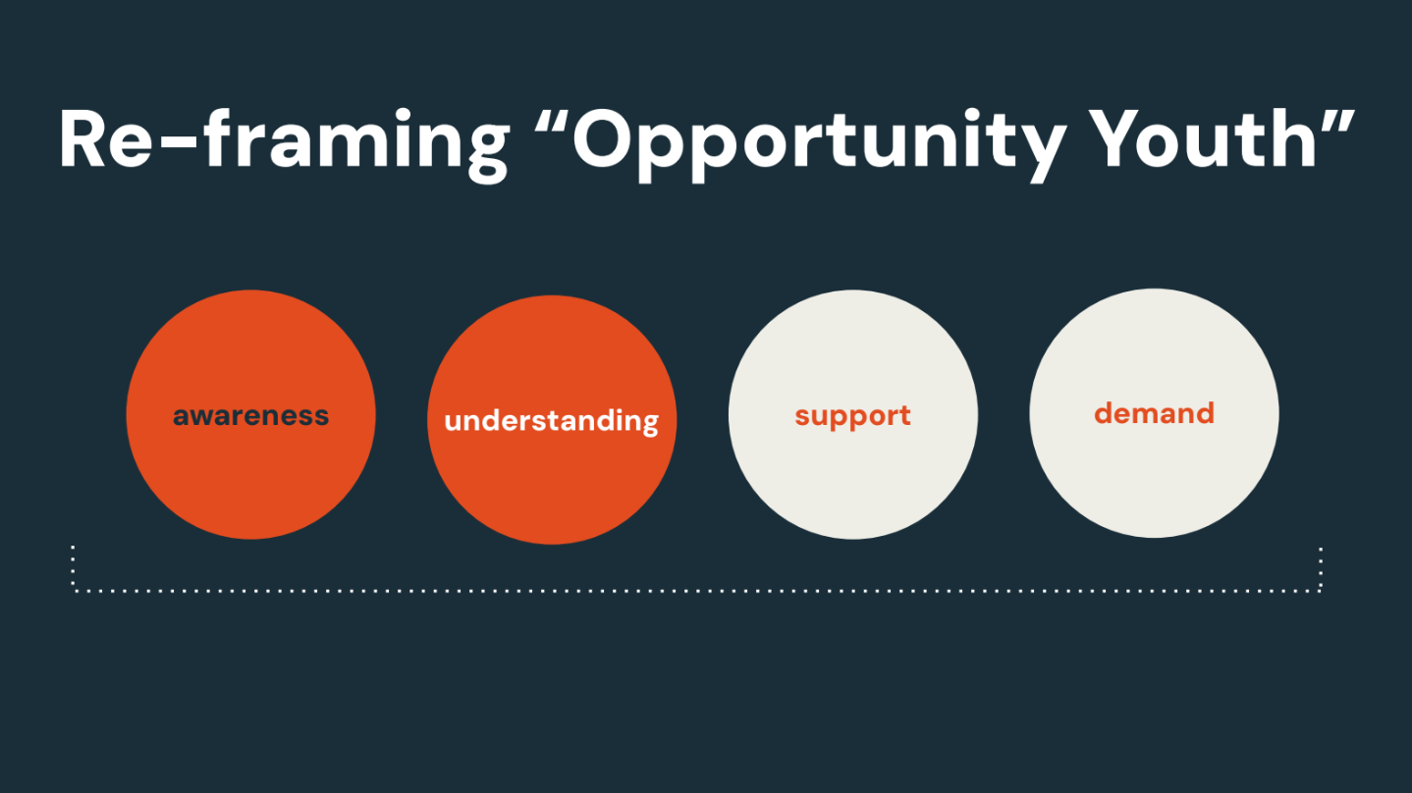

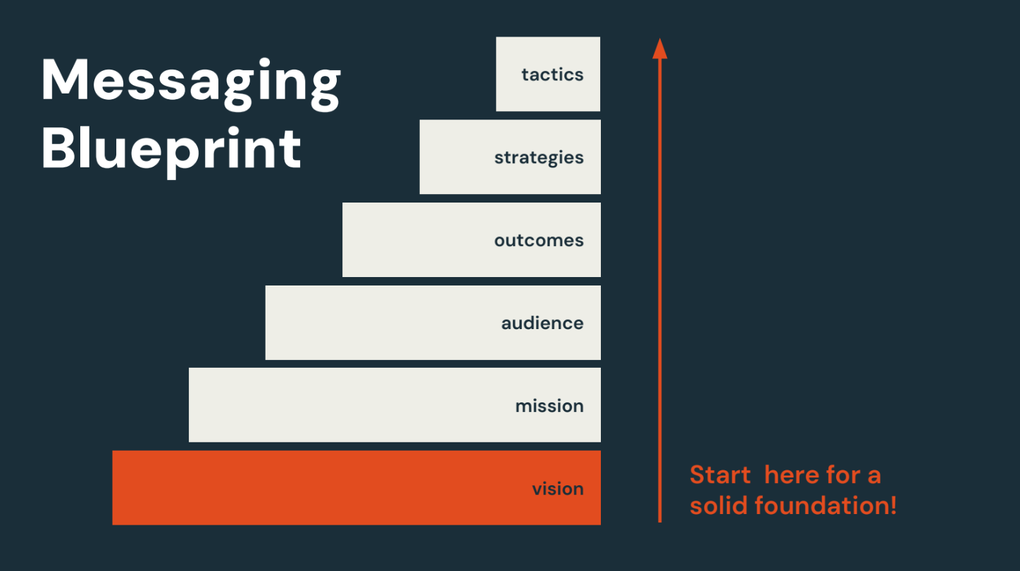
Frameworks trains orgs supporting young people on creating narrative shifts that drive systemic change
Frameworks provides research-based framing strategies and communication best practices to effectively engage audiences and generate support for systemic change.
Frameworks emphasizes the need to move beyond labels like "Opportunity Youth" and instead provide context that highlights the challenges these young people face while emphasizing their potential.

Slide 36
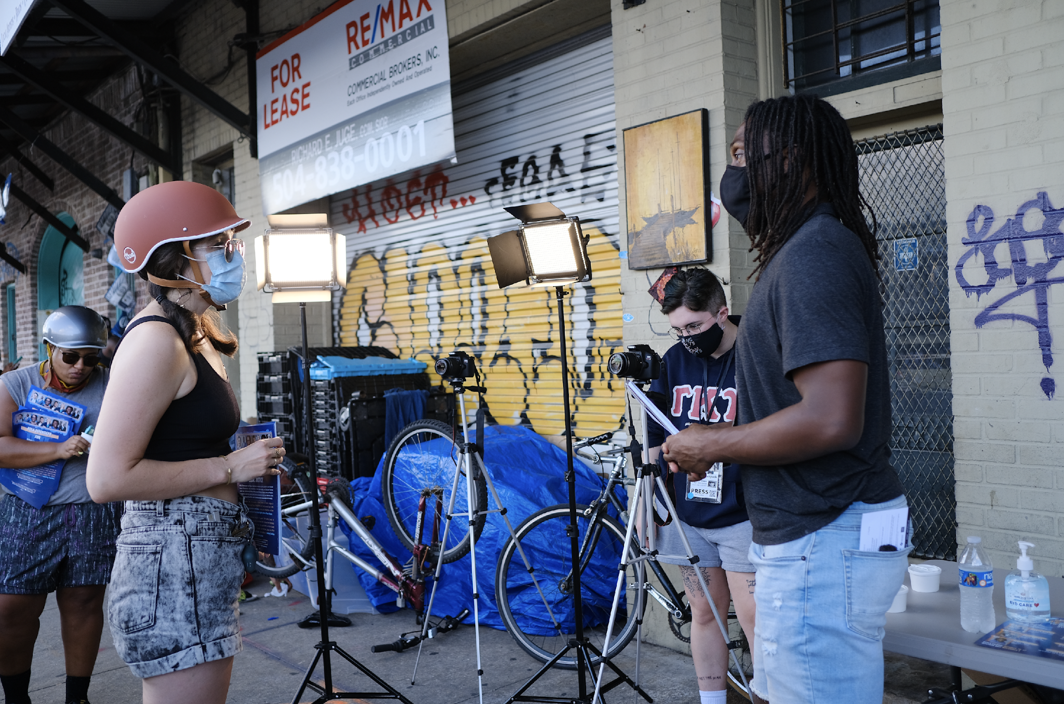

LEDE is empowering New Orleans youth to tell their community’s stories through journalism
LEDE equips creative professionals from underrepresented communities, age 18-25, with skills, tools and resources to transform the local information ecosystem.
For New Orleans to thrive, we must build a more equitable information ecosystem, where all people have access to high-quality information that is relevant to their lived experiences. We are training young storytellers to step in and meet that need.
Source: LEDE Strategy Overview, LEDE Photos

Slide 37
In summary, partners supporting young people achieve significant wins for the ecosystem through integrated capabilities.
Significant Wins in Strengthening Capabilities
Data Collaborative Impact
New Orleans Career Center
NOLA-YPQI Network
Policy and Advocacy
Youth Voice
This collaborative has allowed peer organizations to unite, exchange knowledge, and share wins, leading to better data-driven decisions and more effective programming
The New Orleans Career Center was launched to prepare high school and adult trainees for employment in high-wage, high demand industry sectors.
Young people throughout New Orleans are receiving higher quality service and program standards than ever before
This includes the establishment of the Youth Master Plan and efforts to improve transportation access for Opportunity Youth. Additionally, OY leaders formed the Louisiana Opportunity Youth Alliance (LOYAL) to focus on narrative change and advocacy.
Young people are owning their voices in their stories through LEDE, and Frameworks is supporting narrative change throughout the ecosystem

Slide 38

CHAPTER 3
Hopes and Dreams for a Thriving Opportunity Youth Ecosystem

Slide 39
Throughout interviews, leaders shared their hopes and dreams for the future of the youth of New Orleans and their communities
“My hope is that young people can find and access community better. Healing work is connected to community connection and social connection.”​
“We need to make sure that in the OY space, we create the ways that let the youth identify and create their value. Troubled youth are the product of steady disinvestments. Successful youth live in worlds that value connection; this knowledge is crucial to future investments.”​
“I want to see young people have the freedom and autonomy to navigate the world on their own terms, exploring their interests without feeling constrained.”​
“There’s too much focus on individual change as opposed to systemic change. A young person could do everything right but still enter a system of inequity.”​
“
Quotes from OY leaders”​
Youth Empowerment and Building Connections​
Creating Value and Overcoming Disinvestment​
Autonomy and Exploration​
Systemic Change and Equity​

Slide 40
Key lessons and funding strategies were observed from grantees as CNHF and funders look toward the future
Key Lessons and Funding Strategies based on Stakeholder Interviews
Lesson​ | Explanation​ | Funding Insights​
Importance of a Place-Based Commitment​ | Sustainable impact requires long-term, place-based commitment from funders, paired with flexibility to adapt to changing circumstances.​ | Funders should consider multi-year funding commitments, especially in regions of major disasters / emergencies, and remain open to adjusting strategies as needs evolve.​
The Power of Collaboration Over Competition​ | Shifting from a competitive mindset to one of collaboration has led to significant wins within the OY ecosystem.​ | Encouraging and funding collaborative initiatives rather than siloed projects can lead to more holistic solutions.​
Need for Systemic Change with Individual Program Success​ | Individual program success should work in parallel to addressing systemic barriers, such as structural inequities, lack of access to resources, and fragmented services.​ | Investments should focus not only on programmatic interventions but also on driving systemic change. This could include policy advocacy, cross-sector partnerships, and initiatives aimed at addressing the root causes of youth disconnection.​
Data as a Tool for Strategic Decision-Making​ ​ | Reliable data is essential for understanding the long-term impact of programs and making informed decisions. However, several interviewees pointed out the challenges in data collection and sharing across organizations.​ | Funders could invest in initiatives that build the data capacity of local organizations and foster a culture of data-driven decision-making.​

Slide 41
Key lessons and funding strategies were observed from grantees as CNHF and funders look toward the future
Key Lessons and Funding Strategies based on Stakeholder Interviews
Lesson​ | Descriptions​ | Funding Insights​
Addressing Imm- ediate Needs While Planning for the Long-Term​ | Immediate barriers, such as transportation and housing, must be addressed alongside long-term goals like career development and education, so Opportunity Youth cannot fully engage with longer-term opportunities.​ | Funders could support programs that offer holistic services, combining short-term relief with pathways to sustainable futures.​
Importance of Listening to Youth Voices​ | Effective programs are those that listen to and incorporate the voices of Opportunity Youth. Interviewees mentioned that when youth are involved in designing and evaluating programs, the initiatives are more likely to succeed.​ | Encouraging youth participation in program design and decision-making processes ensures that investments align with their actual needs and aspirations. The Foundation could fund initiatives that prioritize youth leadership and co-creation.​
Resilience and Adaptability in the Face of Challenges​ | The need for emergency funds, mental health support, and flexible programming to address vulnerabilities in OY ecosystem became evident with COVID-19 pandemic​ | Building resilience into the funding strategy is crucial. The Foundation should consider creating emergency funds, supporting mental health initiatives, and allowing grantees flexibility in how they use funds to adapt to crises.​

Slide 42

So, what does the path forward look like for the ever-evolving youth ecosystem of New Orleans?​
Data Community of Practice
Data: Build quality data in the OY Data Community of Practice, advocate for relevant studies through LA FIRST, and continue for advocacy of the City of New Orleans Youth Data Hub​
Population Focus: Focus efforts on finding a home for the ReEngagement Center, continue to grow the impact of the New Orleans Career Center, and identify public dollars for the wrap around services and mental health​
Policy: Maintain LOYAL momentum at the state level, ensure new administration keeps and names OY Champion, engage new Mayor, continue Office of Youth and Families​
Narrative Change: Share and push narrative change within OY ecosystem, tell a cohesive NOLA OY story​
Program Quality: Continue to provide resources, technical support and training in ensuring program quality
Population focus (Supports and Seats)
Voice and Narrative Change
Integrated
Capabilities
Practice - Program Quality
Policy / Advocacy

